Slide 1
Artificial Intelligence
Chapter 11: Planning
Abu Saleh Musa Miah
Department of Computer Science
BAUST
April 3, 2006
AI: Chapter 11: Planning

Slide 2
Contents
Search vs. Planning
The Language of Planning Problems
STRIPS Operators
Partial Order Planning
CLIPS
April 3, 2006
AI: Chapter 11: Planning

Slide 3
Introduction
Planning is the task of coming up with a sequence of actions that will achieve the goal
Classical planning environments
  Fully observable, deterministic, finite, static (change only happens when the agent acts), and discrete (in time, action, objects)
April 3, 2006
AI: Chapter 11: Planning

Slide 4
Introduction
A plan is complete iff every precondition is achieved
A precondition is achieved iff it is the effect if an earlier step and no possibly intervening step undoes it
April 3, 2006
AI: Chapter 11: Planning

Slide 5
Problem of Searching
Let us consider what car) happen when an ordinary problem-solving agent using standard
search algorithms-depth[-first, A*, and so on-comes up against large, real-world problems.
That will help us design better planning agents.
The most obvious difficulty is that the roblem-solving agent can be overwhelmed by irrelevant actions.

Slide 6
Search vs. Planning
Consider a Internet Buying Agent whose task it is to buy our text book (search based)
  ISBN# 0137903952
One buying action for each 10-digit ISBN number, for a total of 10 billion actions
  10⁹ possibilities
  Searched based agent
    One buying action for each ISBN number
    Difficult to find a good heuristic
  Planning based agent
    Work backwards
    Goal is Have(0137903952)
    Have(x) results from Buy(x)
    Therefore Buy(0137903952)

Slide 7
Search vs. Planning
The next difficulty is finding a good heuristic function.
Now let’s buy 4 books…
  10⁴⁰ plans of just 4 steps using searching
    Must search with a heuristic
      Use # books remaining?
      Not useful for our agent since it sees the goal test only as a black box that returns True or False for each state
      Lacks autonomy; requires a human to supply a heuristic function for each new problem
April 3, 2006
AI: Chapter 11: Planning

Slide 8
Search vs. Planning
If our planning agent could use a conjunction of subgoals
  Then it could use a single domain-independent heuristic
    The number of unsatisfied conjuncts
  For the book-buying problem, the goal would be Have(A) ∧ Have(B) ∧ Have(C) ∧ Have(D)
  A state containing Have(A) ∧ Have(B) would have a cost 2
Thus, the agent automatically gets the right heuristic for this problem, and for many others.

Slide 9
Search vs. Planning
Finally, the problem solver might be inefficient because it cannot take advantage of problem decomposition.
Another example:
  Consider the task of getting milk, bananas, and a cordless drill
    Really want to go to supermarket and then go to the hardware store
    But we could get sidetracked!
      By irrelevant actions
April 3, 2006
AI: Chapter 11: Planning

Slide 10
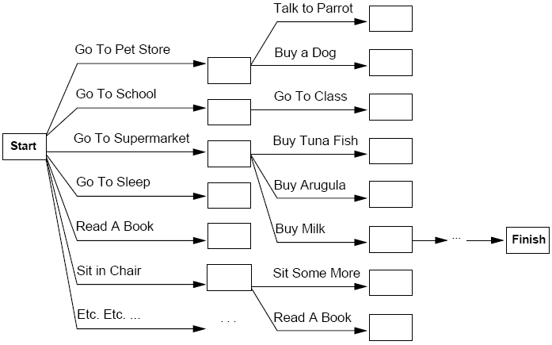
Search vs. Planning
April 3, 2006
AI: Chapter 11: Planning

Slide 11
Search vs. Planning
Planning Systems do the following:
  Open up action and goal representation to allow selection
  Divide-and-conquer by sub-goaling
  Relax requirement for sequential construction of solutions
April 3, 2006
AI: Chapter 11: Planning

Slide 12
The Language of Planning Problems
Representation of states
  Planner Decompose the world into logical conditions and represent a state as a conjunction of positive literals
  Must be ground and function-free
  Examples: We will consider propositional literals
    Poor ∧ Unknown represent the state of a hapless agent
We will also use first-order literals;
    At( Plane₁, Melbourne ) ∧ At( Plane₂, LAS ) represent a state in the package delivery problem
At(x,y) or At( Father(Fred), CLE) (not allowed) The closed-world assumption is used, meaning that any conditions that are not mentioned in a state are assumed false.

Slide 13
The Language of Planning Problems
Representation of goals
  A partially specified state
  Represented as a conjunction of ground literals
  Examples
    At( Plane₁, LAS )
    Rich ∧ Famous
  State s satisfies goal g if s contains all the atoms in g (and possibly others)
    Rich ∧ Famous ∧ Miserable satisfies Rich ∧ Famous
April 3, 2006
AI: Chapter 11: Planning

Slide 14
The Language of Planning Problems
Representation of actions
  Specified in terms of the preconditions that must hold before it can be executed and the effects that ensue when it is executed
  example, an action for flying a plane from one location to another is:
  Action( Fly( p, from, to ))
    Precond: At(p, from) ∧ Plane(p) ∧ Airport(from) ∧ Airport(to)
    Effect: ¬ At(p, from) ∧ At(p, to)
  This is also known as an action schema
April 3, 2006
AI: Chapter 11: Planning

Slide 15
Representations for actions
Our STRIPS operators consist of three components:
The action name and parameter list-for example, Fly(p, from, to)-serves to identify the action.
The precondition is a conjunction of atoms (positive literals) that says what must be true before the operator can be applied.
The effect of an operator is a conjunction of literals (positive or negative) that describes how the situation changes when the operator is applied.
Here’s an example for the operator for going from one place to another:
Op(Action:Go(there), Precond:At(here)^Path(here, there), Effect:At(there)^ ¬At(here))

Slide 16
Search vs. Planning Again
Search
  States: program data structures
  Actions: program code
  Goal: program code
  Plan: sequence from S₀
Planning
  States: logical sentences
  Actions: preconditions and outcomes
  Goal: logical sentences (conjunction)
  Plan: constraints on actions
April 3, 2006
AI: Chapter 11: Planning

Slide 17
Problem Solving vs. Planning
A simple planning agent is very similar to problem-solving agents in that it constructs plans that achieve its goals, and then executes them. The limitations of the problem-solving approach motivates the design of planning systems.
To solve a planning problem using a state-space search approach we would let the:
initial state = initial situation
• goal-test predicate = goal state description
• successor function computed from the set of operators
• once a goal is found, solution plan is the sequence of operators in the path from the start node to the goal node

Slide 18
Example
Suppose our current state is:
  At(P1, CLE) ∧ At(P2, LAS) ∧ Plane(P1) ∧ Plane(P2) ∧ Airport(CLE) ∧ Airport(LAS)
This state satisfies the precondition
  At(p, from) ∧ Plane(p) ∧ Airport(from) ∧ Airport(to)
Using the substitution
  {p/P1, from/CLE, to/LAS}
The following concrete action is applicable
  Fly( P1, CLE, LAS)
April 3, 2006
AI: Chapter 11: Planning

Slide 19
STRIPS
if a positive effect is already in s it is not added twice, and if a negative effect is
not in s, then that part of the effect is ignored. This definition embodies the so-called STRIPS
STRIPS ASSUMPTION assumption: that every literal not mentioned in the effect remains unchanged. In this way,
STRIPS avoids the representational frame problem Finally, we can define the solution for a planning problem. In its simplest form, this is
just an action sequence that, when executed in the initial state, results in a state that satisfies
the goal.
April 3, 2006
AI: Chapter 11: Planning

Slide 20
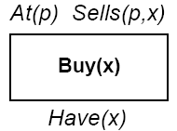
STRIPS
STanford Research Institute Problem Solver
A restricted language for planning that describes actions and descriptions of objects in a system
Example
  Action: Buy(x)
  Precondition: At(p), Sells(p, x)
  Effect: Have(x)
April 3, 2006
AI: Chapter 11: Planning

Slide 21
STRIPS
This abstracts away many important details!
Restricted language -> efficient algorithm
  Precondition: conjunction of positive literals
  Effect: conjunction of literals
A complete set of STRIPS operators can be translated into a set of successor-state axioms.
April 3, 2006
AI: Chapter 11: Planning

Slide 22
Initializing the algorithm
Start node
  preconditions: none
  effects: positive literals defining the start state
Finish node
  preconditions: goal
  effects: none
Initial plan
  Start ---------------> Finish

Slide 23
STRIPS
Only positive literals in states:
  Poor ∧ Unknown
Closed world assumption:
  Unmentioned literals are false
Effect P ∧ ¬Q:
  Add P and delete Q
Only ground literals in goals:
  Rich ∧ Famous
April 3, 2006
AI: Chapter 11: Planning

Slide 24
STRIPS
Goals are conjunctions:
  Rich ∧ Famous
Effects are conjunctions:
No support for equality
No support for types
April 3, 2006
AI: Chapter 11: Planning

Slide 25
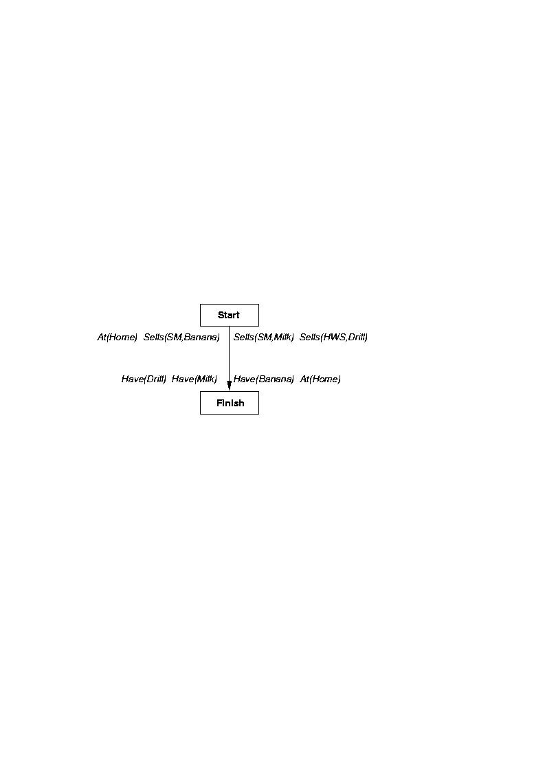
Example Problem

Slide 26
ADL Action Description Language
Positive and negative literals in states:
  ¬ Rich ∧ ¬ Famous
Open world assumption:
  Unmentioned literals are unknown
Effect P ∧ ¬Q:
  Add P and ¬ Q and delete ¬ P and Q
Quantified variables in goals:
  ∃x At(P₁, x) ∧ At(P₂, x) is the goal of having P₁ and P₂ in the same place
April 3, 2006
AI: Chapter 11: Planning

Slide 27
ADL
Goals allow conjunction and disjunction:
  ¬ Poor ∧ (Famous ∨ Smart)
Conditional Effects are allowed:
  when P: E means E is an effect only if P is satisfied
Equality predicate built in:
  (x = y)
Variables can have types:
  (p : Plane)
April 3, 2006
AI: Chapter 11: Planning

Slide 28
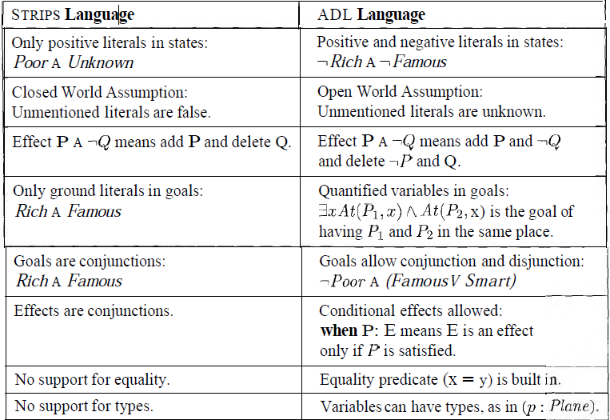
Figure 11.1 Comparisson of STRIPS and ADL languages for representing planning problems. In both cases, goals behave as the preconditions of an action with no parameters.

Slide 29
Example: Air Cargo Transport
Figure 1 1.2 shows an air cargo transport problem involving loading and unloading cargo onto and off of planes and flying it from place to place.
The problem can be defined with three actions: Load, Unload, and Fly.
The actions affect two predicates: In(c, p) means that cargo c is inside plane p, and A t ( x , a) means that object x (either plane or cargo) is at airport a.
Note that cargo is not At anywhere when it is In a plane, so At really means "available for use at a given location." It takes some experience with action definitions to handle such details consistently.
April 3, 2006
AI: Chapter 11: Planning

Slide 30
Example: Air Cargo Transport
Init(At(C₁, CLE) ∧ At(C₂, LAS) ∧ At(P₁, CLE) ∧ At(P₂, LAS) ∧ Cargo(C₁) ∧ Cargo(C₂) ∧ Plane(P₁) ∧ Plane(P₂) ∧ Airport(CLE) ∧ Airport(LAS))
Goal( At(C₁, LAS) At(C₂, CLE))
April 3, 2006
AI: Chapter 11: Planning

Slide 31
Example: Air Cargo Transport
Action( Load(c, p, a),
  Precond: At(c, a) ∧ At(p, a) ∧ Cargo(c) ∧ Plane(p) ∧ Airport(a)
  Effect: ¬ At(c, a) ∧ In(c, p))
Action( Unload(c, p, a),
  Precond: In(c, p) ∧ At( p, a) ∧ Cargo(c) ∧Plane(p) ∧ Airport(a)
  Effect: At(c, a) ∧ ¬ In(c, p))
Action( Fly( p, from, to),
  Precond: At(p, from) ∧ Plane(p) ∧ Airport(from) ∧ Airport(to)
  Effect: ¬ At(p, from) ∧ At(p, to))
April 3, 2006
AI: Chapter 11: Planning

Slide 32
Example: Air Cargo Transport
[ Load(C₁, P₁, CLE), Fly(P₁, CLE, LAS), Unload( C₁, P₁, LAS),
Load(C₂, P₂, LAS), Fly(P₂, LAS, CLE), Unload( C₂, P₂, CLE)]
Is it possible for a plane to fly to and from the same airport?
Our representation is pure STRIPS. In particular, it allows a plane to fly to and from the same airport. Inequality literals in ADL could prevent this.
April 3, 2006
AI: Chapter 11: Planning

Slide 33
Example: The Spare Tire Problem
Consider the problem of changing a flat tire. More precisely, the goal is to have a good spare tire properly mounted onto the car's axle, where the initial state has a flat tire on the axle and a good spare tire in the trunk.
To keep it simple, our version of the problem is a very abstract one, with no sticky lug nuts or other complications.
There are just four actions: removing the spare from the trunk, removing the flat tire from the axle, putting the spare on the axle, and leaving the car unattended overnight.
We assume that the car is in a particularly bad neighborhood, so that the: effect of leaving it overnight is that the tires disappear.
April 3, 2006
AI: Chapter 11: Planning

Slide 34
Example: The Spare Tire Problem
Init( At( Flat, Axle) ∧ At( Spare, Trunk))
Goal( At(Spare, Axle))
April 3, 2006
AI: Chapter 11: Planning

Slide 35
Example: The Spare Tire Problem
Action( Remove( Spare, Trunk ),
  Precond: At( Spare, Trunk )
  Effect: ¬ At( Spare, Trunk) ∧ At( Spare, Ground))
Action( Remove( Flat, Axle ),
  Precond: At(Flat, Axle )
  Effect: ¬ At(Flat, Axle) ∧ At(Flat, Ground))
Action( PutOn( Spare, Axle ),
  Precond: At( Spare, Ground ) ∧ ¬ At (Flat, Axle )
  Effect: ¬ At( Spare, Ground ) ∧ At( Spare, Axle ))
Action( LeaveOvernight,
  Precond:
  Effect: ¬ At( Spare, Ground ) ∧ ¬ At(Spare, Axle) ∧ ¬ At(Spare, Trunk) ∧ ¬ At(Flat, Ground) ∧ ¬ At(Flat, Axle)
April 3, 2006
AI: Chapter 11: Planning

Slide 36
Example: The Blocks World
Init( On(A, Table) ∧ On(B, Table) ∧ On(C, Table) ∧ Block(A) ∧ Block(B) ∧ Block(C) ∧ Clear(A) ∧ Clear(B) ∧ Clear(C))
Goal( On(A, B) ∧ On(B, C))
April 3, 2006
AI: Chapter 11: Planning

Slide 37
Example: The Blocks World
Action( Move( b, x, y ),
  Precond: On(b,x) ∧ Clear(b) ∧ Clear(y) ∧ Block(b) ∧ (b ≠ x) ∧(b≠y) ∧ (x ≠ y)
  Effect: On(b, y) ∧ Clear(x) ∧ ¬ On(b,x) ∧ ¬ Clear(y))
Action( MoveToTable(b, x ),
  Precond: On(b, x) ∧ Clear(b) ∧ Block(b) ∧ (b ≠ x)
  Effect: On(b, Table) ∧ Clear(x) ∧ ¬ On(b, x))
April 3, 2006
AI: Chapter 11: Planning

Slide 38
Example: The Blocks World
A plan for building a three block tower
[Move(B, Table, C), Move(A, Table, B)]
April 3, 2006
AI: Chapter 11: Planning

Slide 39
Representation of Plans
Consider a simple problem:
  Putting on a pair of shoes
Goal →RightShoeOn ^ LeftShoeOn
Four operators:
  Op(Action:RightShoe,PreCond:RightSockOn,Effect:RightShoeON)
  Op(Action:RightSock , Effect: RightSockOn)
  Op(Action:LeftShoe, Precond:LeftSockOn, Effect:LeftShoeOn)
  Op(Action:LeftSock,Effect:LeftSockOn)

Slide 40
Least Commitment –
One should make choices only about things that you currently care about ,leaving the others to be worked out later.
Partial Order Planner –
A planner that can represent plans in which some steps are ordered (before or after) w.r.t each other and other steps are unordered.
Total Order Planner—
Planner in which plans consist of a simple lists of steps
Linearization of P—
A totally ordered plan that is derived from a plan P by adding constraints

Slide 41
Partially Ordered Plans
Partially Ordered Plan
  A partially ordered collection of steps
    Start step has the initial state description and its effect
    Finish step has the goal description as its precondition
    Causal links from outcome of one step to precondition of another step
    Temporal ordering between pairs of steps
April 3, 2006
AI: Chapter 11: Planning

Slide 42
Partial Ordered Plans
An open condition is a precondition of a step not yet causally linked
A plan is complete iff every precondition is achieved
A precondition is achieved iff it is the effect if an earlier step and no possibly intervening step undoes it
April 3, 2006
AI: Chapter 11: Planning

Slide 43
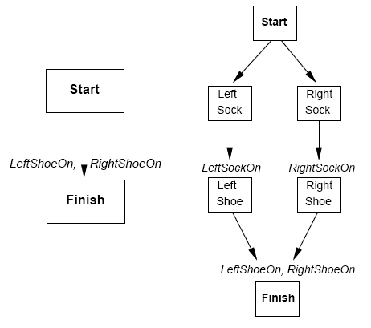
Partially Ordered Plans
Start
Right Sock
Right Shoe
Left Sock
Left Shoe
Finish
April 3, 2006
AI: Chapter 11: Planning

Slide 44
Partial Order Plans:
Total Order Plans:
Start
Start
Start
Start
Start
Start
Start
Right
Sock
Right
Sock
Left
Sock
Left
Sock
Right
Sock
Left
Sock
Left
Sock
Right
Sock
Left
Sock
Left
Sock
Right
Sock
Right
Sock
Right
Shoe
Left
Shoe
Left Sock on
Right Sock on
Left
Shoe
Right
Shoe
Right
Shoe
Left
Sock
Right
Shoe
Left
Shoe
Left
Sock
Right
Sock
Left Shoe on
Right Shoe on
Left
Shoe
Right
Shoe
Left
Shoe
Right
Shoe
Left
Shoe
Right
Shoe
Finish
Finish
Finish
Finish
Finish
Finish
Finish

Slide 45
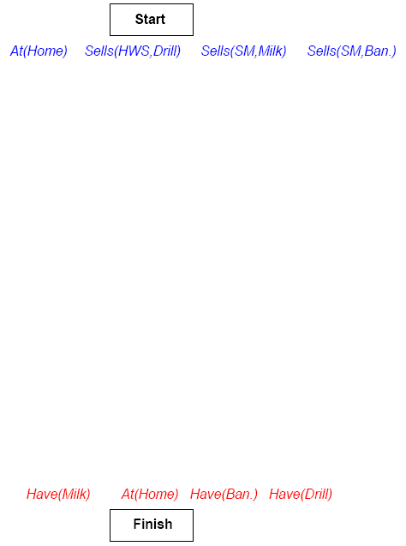
Partially Ordered Plans
April 3, 2006
AI: Chapter 11: Planning

Slide 46
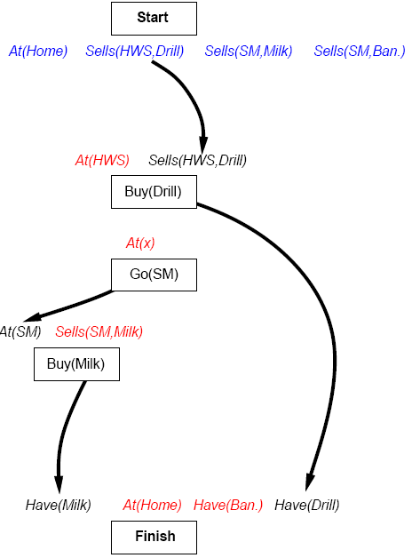
Partially Ordered Plans
April 3, 2006
AI: Chapter 11: Planning

Slide 47
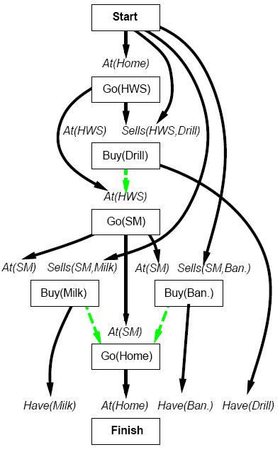
Partially Ordered Plans
April 3, 2006
AI: Chapter 11: Planning

Slide 48
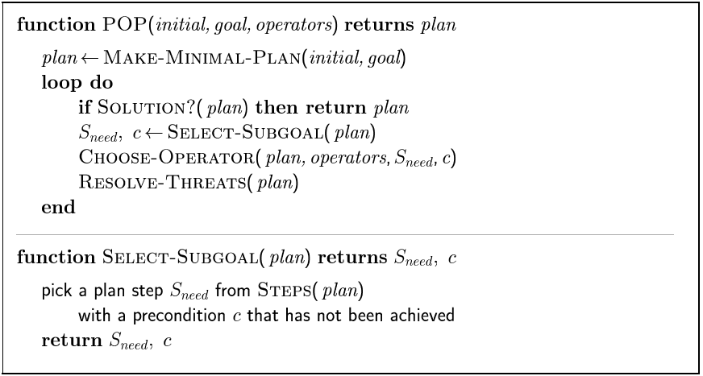
POP Algorithm
April 3, 2006
AI: Chapter 11: Planning

Slide 49
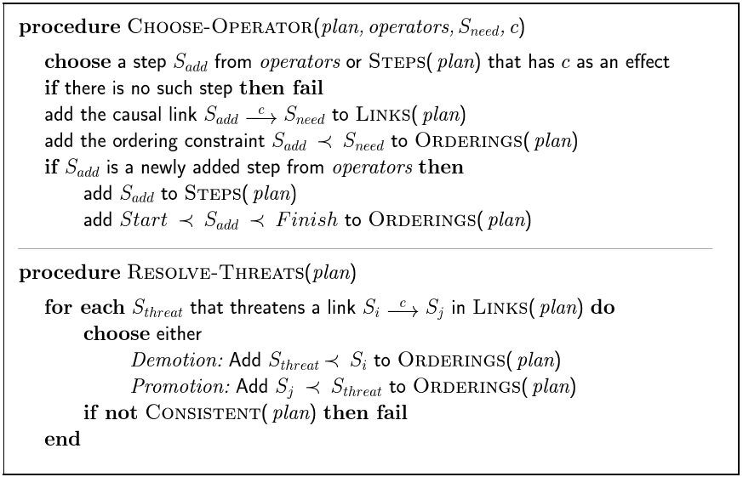
POP Algorithm
April 3, 2006
AI: Chapter 11: Planning

Slide 50
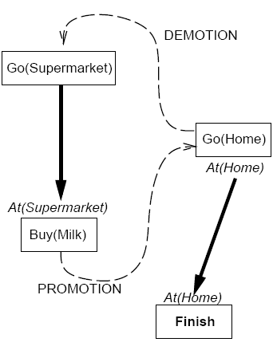
Clobbering
A clobberer is a potentially intervening step that destroys the condition achieved by a causal link
  Example Go(Home) clobbers At(Supermarket)
Demotion
  Put before Go(Supermarket)
Promotion
  Put after Buy(Milk)
April 3, 2006
AI: Chapter 11: Planning

Slide 51
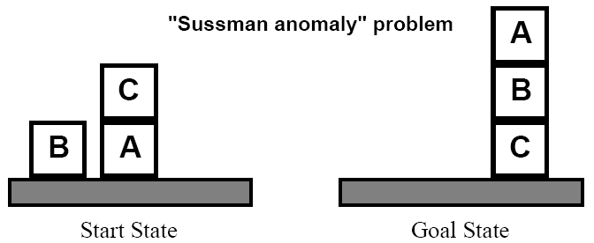
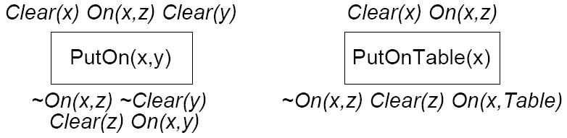
Example: Blocks World
April 3, 2006
AI: Chapter 11: Planning

Slide 52
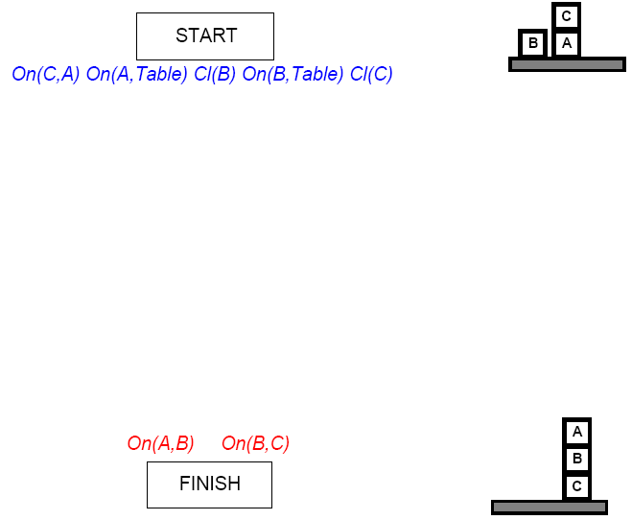
Example: Blocks World
April 3, 2006
AI: Chapter 11: Planning

Slide 53
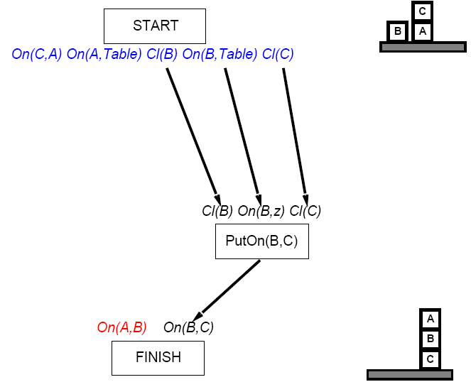
Example: Blocks World
April 3, 2006
AI: Chapter 11: Planning

Slide 54
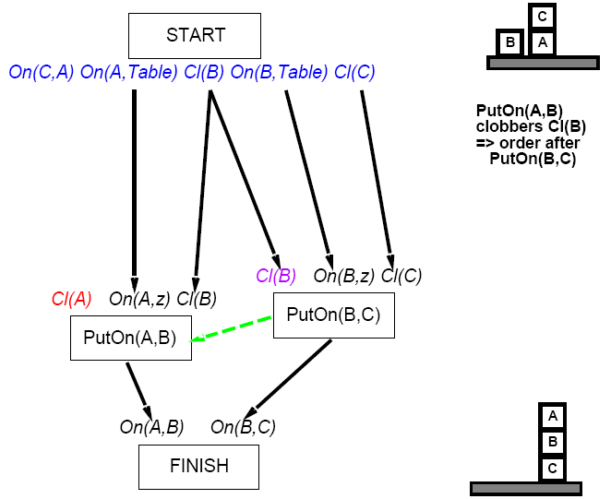
Example: Blocks World
April 3, 2006
AI: Chapter 11: Planning

Slide 55
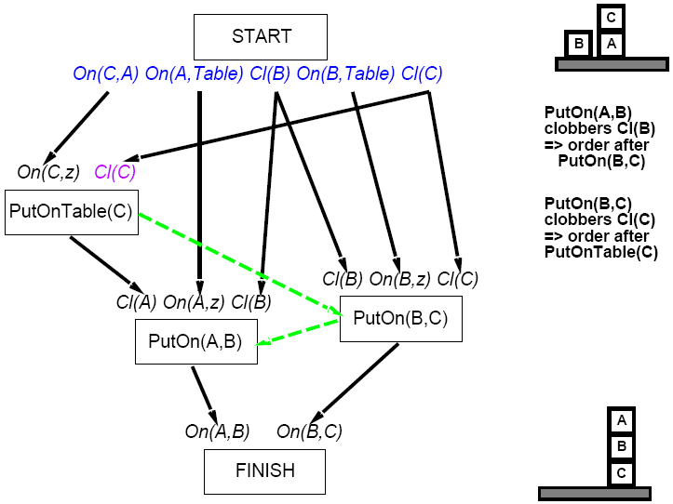
Example: Blocks World
April 3, 2006
AI: Chapter 11: Planning

